Slide 1
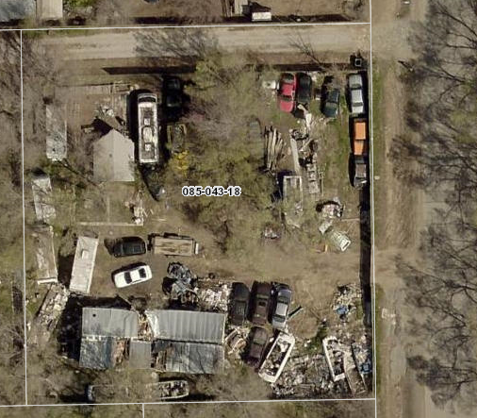
Washoe County Board of Adjustment
WVIO-PLA18-0259 (Carol Drive)
February 7, 2019

Slide 2
Request
This is a request to hear an appeal of an administrative hearing officer’s decision on a code enforcement action regarding the height of a fence in the front yard setback.
The 31,039 sq. ft. property is locate at 5235 Carol Drive.

Slide 3
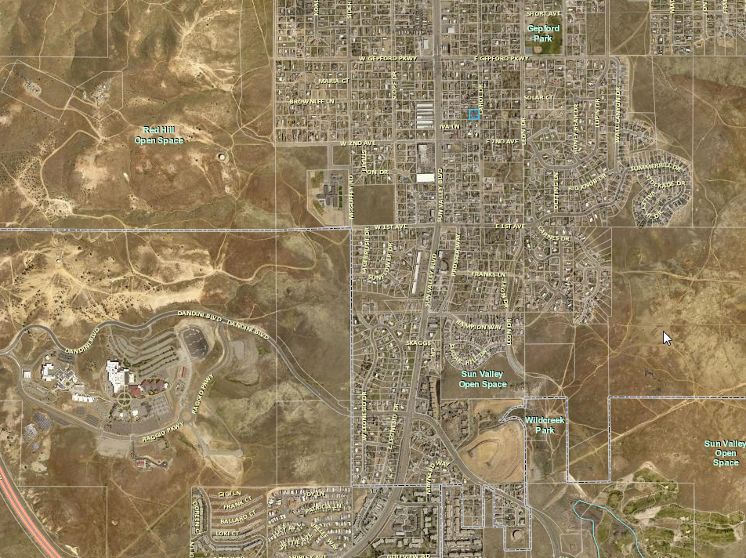
Property Location

Slide 4
Enforcement Background
Enforcement regulations are per WCC Chapter 125, Enforcement; Remedies; Penalties – enabled by 110.910.15(d).
Administrative enforcement procedures include a process for warnings and then escalating penalties if a violation is not corrected.
Issuance of an administrative warning is the first step in the enforcement process – 30 days to correct violation (or agree to a compliance plan).

Slide 5
Background/Overview
A complaint was received on May 25, 2018 alleging the following was occurring at 5235 Carol Drive:
  Junk vehicles were being stored on the property
  Someone was living in a RV
  A structure in disrepair
Upon investigation, the Code Enforcement Officer (CEO) confirmed the junk vehicles, damaged structure and a RV.
However there was a 6 foot fence surrounding the property, including along the street in the front yard setback- a fence in the front yard setback cannot be more than 4 ½ feet high

Slide 6
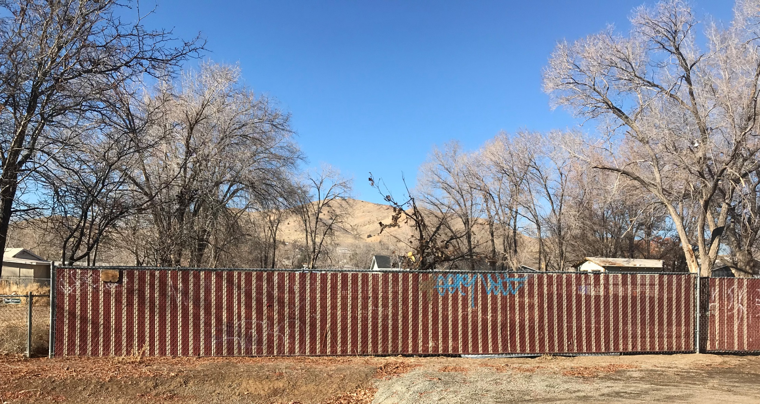
Background

Slide 7
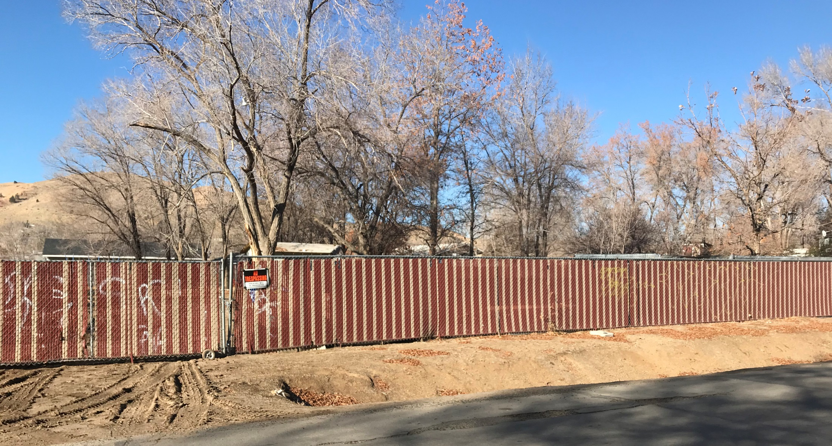
Background

Slide 8
Background/Overview
On June 8th a violation (WVIO-PLA18-0259 ) was opened for the 6-foot fence in the front yard setback and the property owner had 30 days to remove or alter the fence.
The property owner stated that the previous owner had obtained a variance in the 1980’s for the fence and that there had been code violation on the property and the Judge ordered the 6-foot fence to be installed to screen the property.
It does appears that a fence has been on the property since at least 2000, by looking at the orthophotos.

Slide 9
Background/Overview
The property owner made no changes to the fence and the CEO issued a penalty notice on July 18^{th,} which the property owner appealed.
On August 15, 2018 the case was heard by Hearing Officer Elizabeth Byer and she required the following:
  To allow the property owner 60 days to locate the records from Sparks Justice Court, concerning the requirement of the 6-foot fence; and
  To go back to the complaint to find if there was still any issue on the property.

Slide 10
Background/Overview
The owner was not able to locate the document concerning the fence, however they had cleaned up the property.
The Hearing Officer requested a legal opinion from Washoe County to confirm that CEOs had the authority to cite a property for a violation that was not part of the original complaint.
That opinion was provided, stating when a CEO visits a property after a complaint is reported and other violations are found, those violations can be cited.

Slide 11
Background/Overview
On November 5, 2018 the Hearing Officer issued an Administrative Order to dismiss the violation.
The Hearing Officer stated that the debris had been removed and that the fence violation was “merely Washoe County Code Enforcement’s bootstrap method to have the property owner clean-up the property.”

Slide 12
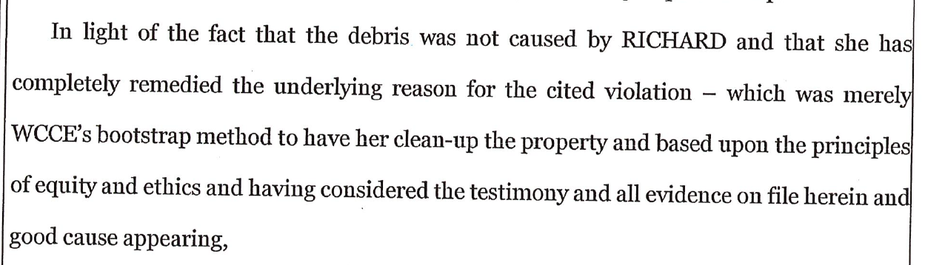
Background/Overview

Slide 13
Analysis
WCC Section 110. 406.50(a), states that a fence, wall or perimeter planting is limited to 4.5 feet high in front yard setback for residential use types
The property is zoned Medium Density Suburban (MDS)
The Washoe County Development Code is the mechanism to maintain neighborhood character in residential areas including standards for fencing, setbacks, height, and landscaping

Slide 14
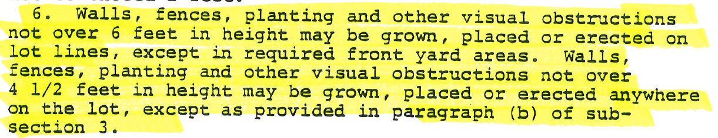
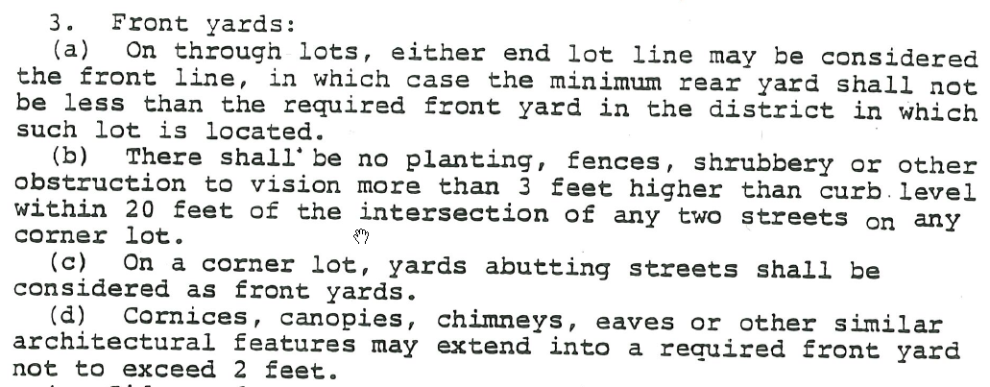
Analysis
The fence height requirement has been the same since 1982

Slide 15
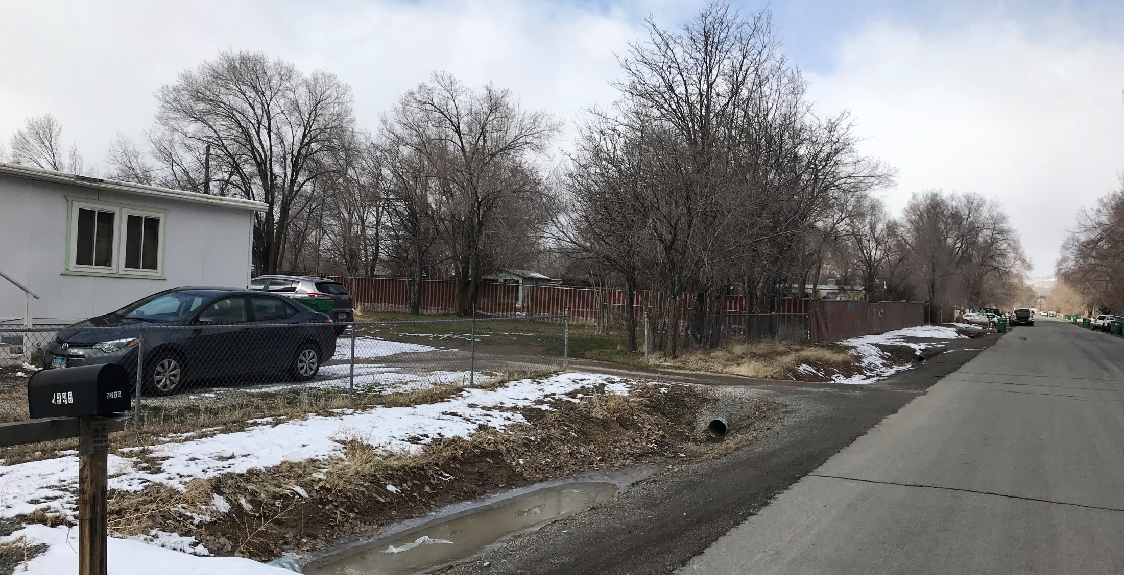
Analysis

Slide 16
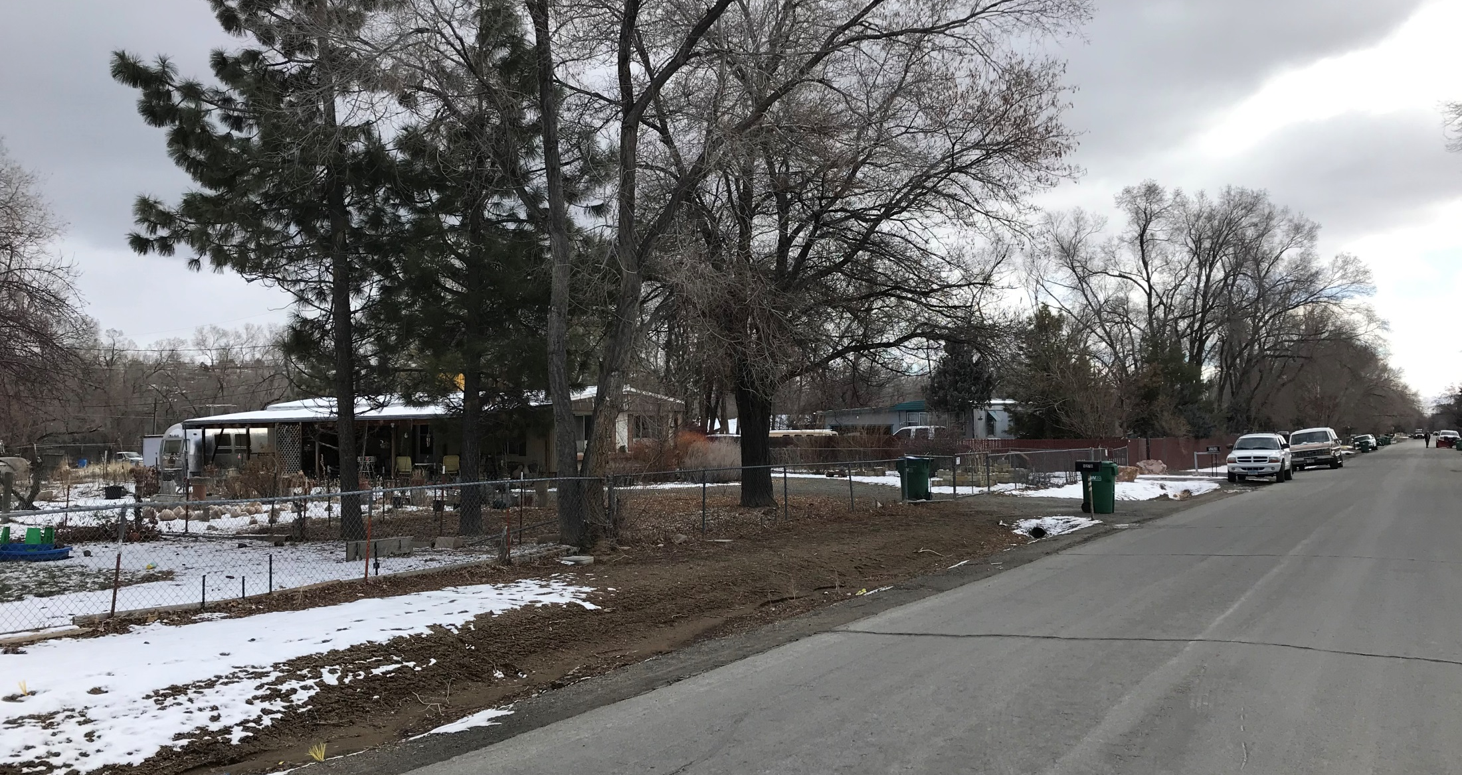
Analysis

Slide 17
Public Notice and CAB
Public notice is not required as part of an administrative enforcement action.
Only noticing requirement is to notice the violator/ appellant, and provide due process.
The appellant has been provided notice and due process as required by Chapter 125.
CAB review and/or input is not part of an administrative enforcement action.

Slide 18
Reviewing Agencies
No other agencies have been involved in this administrative enforcement action.

Slide 19
Findings
The BOA is not required to make specific findings in reaching a decision on this appeal, public record is sufficient
A written order of the BOA’s decision will be prepared, executed by the BOA Chair, and filed with the Secretary of the BOA
A copy of the order is served on the appellant

Slide 20
Possible Motion
I move that, after giving reasoned consideration to the information contained in the staff report and information received during the public hearing, the Washoe County Board of Adjustment approve this appeal and reverse the decision of the Administrative Hearing Officer, that the appellant had not violated WCC Section 110.406.50(a), Fences, Walls or Perimeter Planting, Residential Use Types; and, authorize the Chair of the Board of Adjustment to prepare a written order of the decision and file it with the Secretary of the Board of Adjustment, a copy of which shall be served to the appellant.

Slide 21
Appeal Process
The appellant has the right to appeal the written order by filing a petition for judicial review in the Second Judicial District Court for the State of Nevada within 25 days from the date the order is mailed to the appellant. Per WCC Section 110.910.15(i)(6), when a petition for judicial review is filed, the court rules shall govern the proceeding and the requested judicial review is in lieu of an appeal to the Board of County Commissioners as authorized by NRS 278.310(3)(b).

